Slide 1
SHOPPING COMPLEX BILLING MANAGEMENT SYSTEM

Slide 2

TEAM MEMBERS
CSE2006 Microprocessor and Interfacing
ISHITA SACHAN-19BCE2188
NISHKA SHAH-19BCE2209
HARSHIT TANEJA-19BCE2453
KUNAL SHYAM SAMNANI-19BCE2288

Slide 3
TABLE OF CONTENTS
01
02
OBJECTIVES
METHODOLOGY
03
04
PLANNING AND WORK FLOW
JUSTIFICATION OF DURATION
05
06
COMPONENTS
OUTCOME

Slide 4
01
OBJECTIVES

Slide 5
OBJECTIVES
The main objective of this project is to design a Shopping Complex Bill Management System using Assembly Language.We would make a billing system in which user can easily select an option of choice from the menu and prepare the bill accordingly. We would be using a menu based approach to make the project and will be improving the efficiency of the project by avoiding infinite loop.

Slide 6
02 .METHODOLOGY

Slide 7
1. We will read out the research papers based on the assembly language
project and will try to get more knowledge on how to create a interactive
UI thru assembly language
2. After reading research papers we will list out our software requirements,
hardware requirements and functional requirements in our project
3. We will follow the RAD Model for the project development i.e we will be
focusing more on development rather then planning as it is relatively a
new project
4. After selecting the model we will jump into coding phase and we will be
having around 6 to 7 modules in our project. We will try to make the system
more secure by asking the password and username from the administrator.

Slide 8
5. After partial coding we will design a prototype and get it approved by our project guide.
6. After the coding is done and system is ready to be executed we will check if some infinite loop problems dont occur in our code . We will try to craft the code in a neat manner so to reduce the complexity of the algo
7. After the coding is done we will make a github repository and will start with the testing phase.In the testing phase for BlackBoxTesting we will call some of our classmates and ask them to test our code.For WhiteBox Testing our teammates will test the code.If there are no errors we will proceed with execution for final output.

Slide 9
03. JUSTIFICATION OF DURATION

Slide 10
We have decided to do this project in 2.5 months, we have started from 20th August and we will complete it by 25-October.
First off we will start with selecting the requirement of the project
Secondly would be analysing what we are going to do with the information for nexrt 8 days.
Third milestone will be making a prototype or in simple words making an early sample,choosing a model
Fourth and last, we will work on development for 20days which include testing our code, correcting errors which will lead to final working project

Slide 11
04. PLANNING AND WORK FLOW

Slide 12
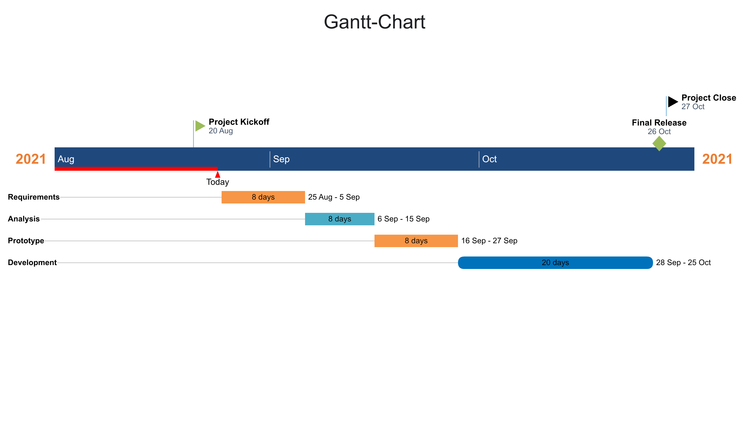

Slide 13
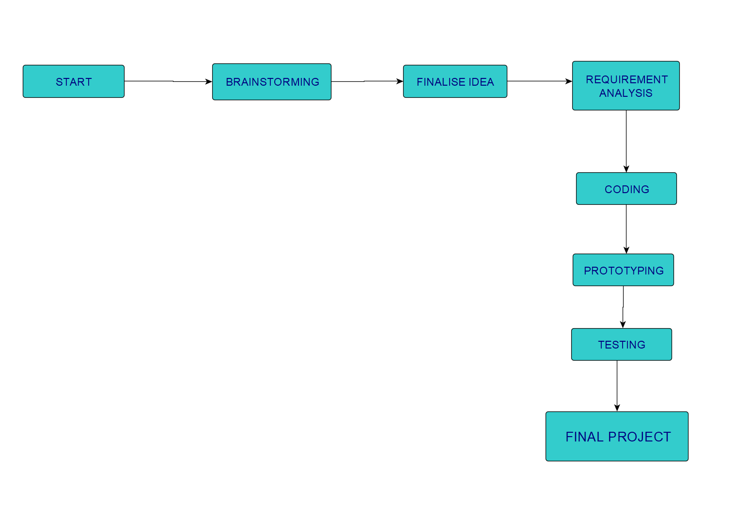
WORKFLOW

Slide 14
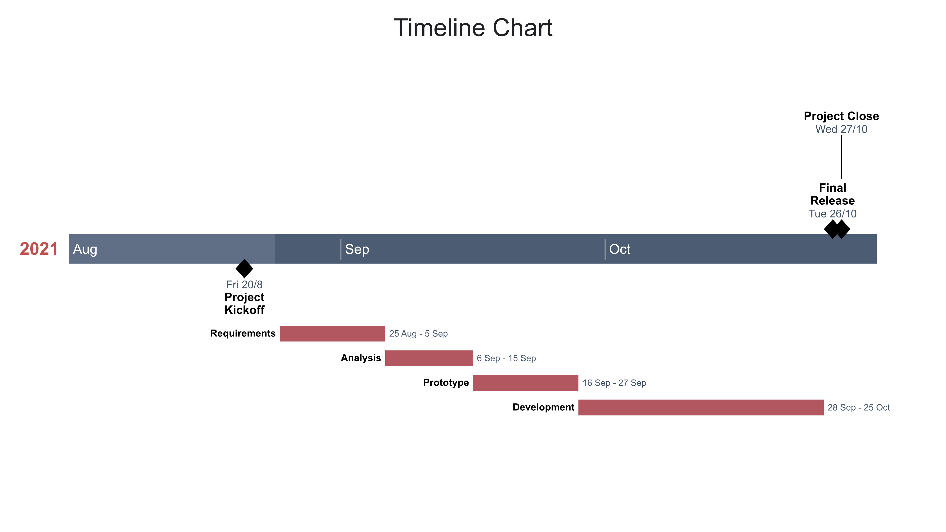

Slide 15

05. COMPONENTS
EMU806

Slide 16
06. OUTCOME OF THE PROJECT
The outcome of the project would be a Shopping ComplexBill Management System which will ease the shopping experience of the customers as they can choose the menu and the total will be calculated automatically leaving the seller with minimal amount of work and make billing items easier for the salesman in the complex.

Slide 17
THANKS!

